Slide 1
Cognitive: Extended Gary Wilson CTO & Technical Leader, UKI Commercial Business

Slide 2
Objective
Extend your chatbot to provide two new functions
Advise on selecting a new mobile phone contract
Allow the user to submit a review of a phone and respond based on user sentiment
Watson Conversation extended functionality
Slots
System entities
Context variables
Watson Natural Language Understanding
Sentiment analysis
Node-RED
Slack

Slide 3
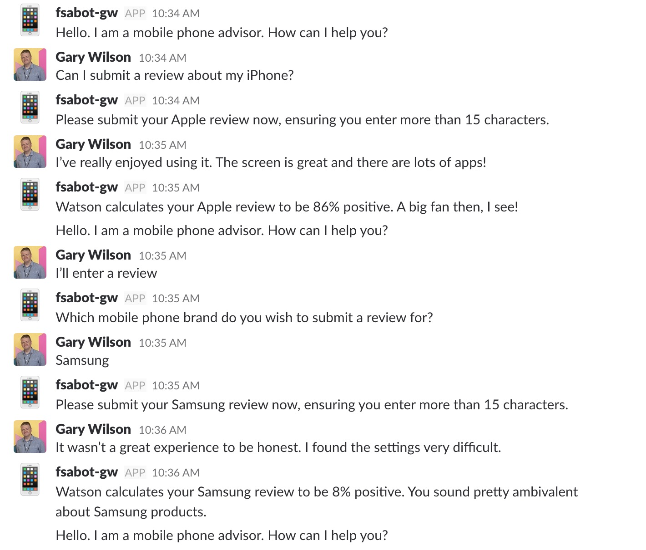
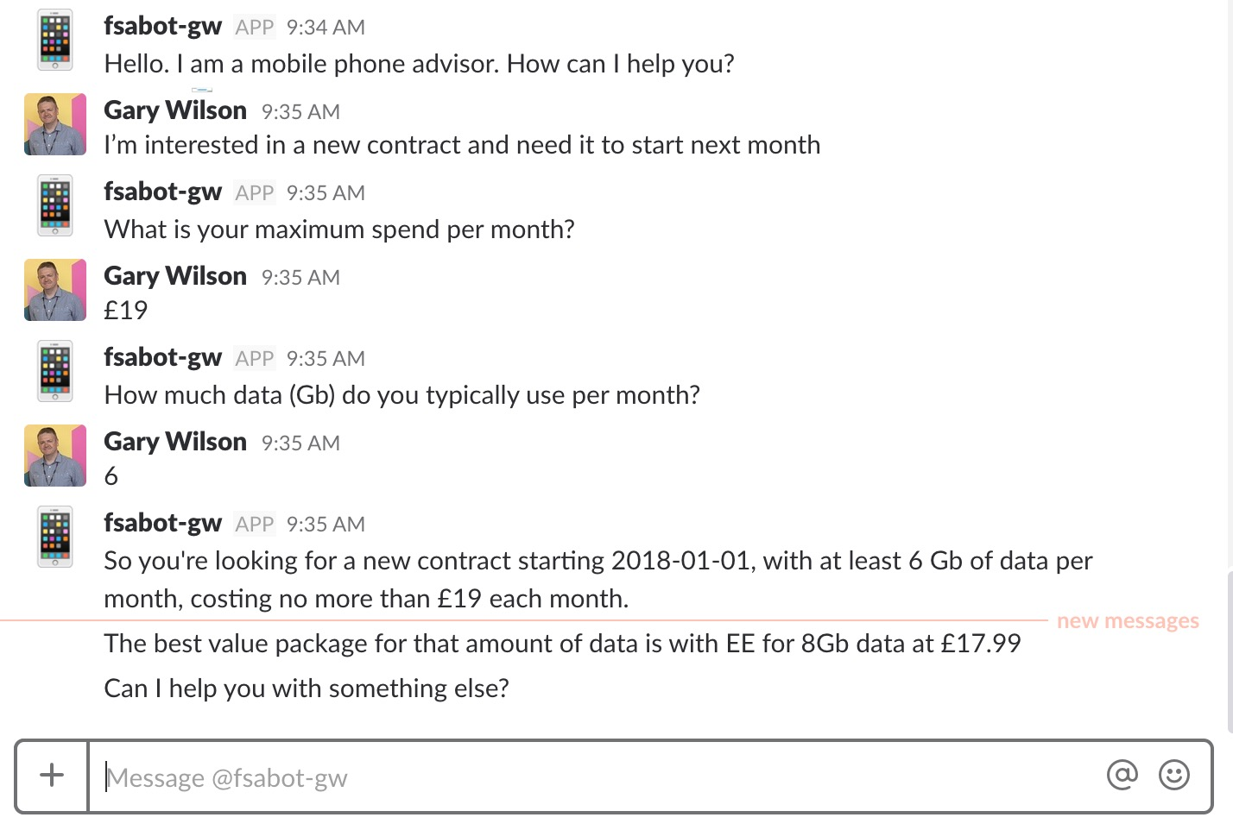
Objective

Slide 4
Agenda
Enhanced Conversation
extend existing dialog to cater for multiple user inputs – ‘slots’
using System Entities to capture context variables
use context variables to pass information between Watson Conversation and your Node-RED application code
Natural Language Understanding
setup an NLU instance
integrate NLU to your Node-RED app to check the sentiment of user input
modify dialog tree to utilise metadata from NLU

Slide 5
Slots
Functionality in Conversation service
Enables developers to use prompts to gather information from users and store the information into context variables
Information to be gathered all at one time can be consolidated into one dialog node
e.g. user’s address, information needed for a reservation
Can be used to ensure dialog has all the required information and prompt the user to enter missing information
Can also be used to handle digressions while collecting information
e.g. if the user asks what are the kitchen hours when they are prompted to enter the time for their reservation, we can give the requested information, then return to the conversation

Slide 6
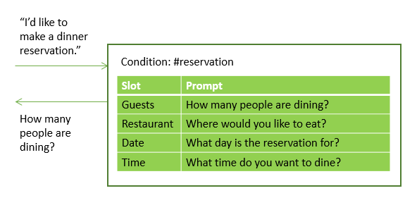
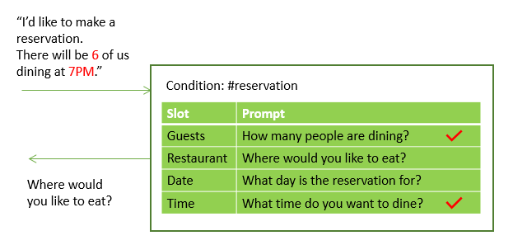
Slots

Slide 7
System entities
Watson Conversation provides a number of system entities
System entities can be used to recognize a broad range of values for the object types they represent, for example,
@sys-number matches any numerical value, including whole numbers, decimal fractions, or even numbers written out as words
@sys-date extracts mentions such as Friday, today, or November 1, and stores the value as the corresponding inferred date as a string in the format "yyyy-MM-dd"
System entities are centrally maintained, so any updates are available automatically

Slide 8
Context variables
Conversation dialog is stateless – your application is responsible for maintaining any continuing information
But … application can pass information to the dialog, and the dialog can update this information and pass it back to the application using context variables
A context variable is a variable that you define in a dialog node
other nodes or application logic can subsequently set or change the value of the context variable
You can test context variables in Watson Conversation dialog node conditions to determine whether to execute a node
And you can reference and use context variables in your application logic … we’ll see this in this lab

Slide 9
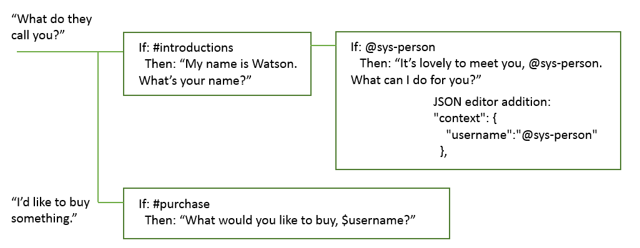
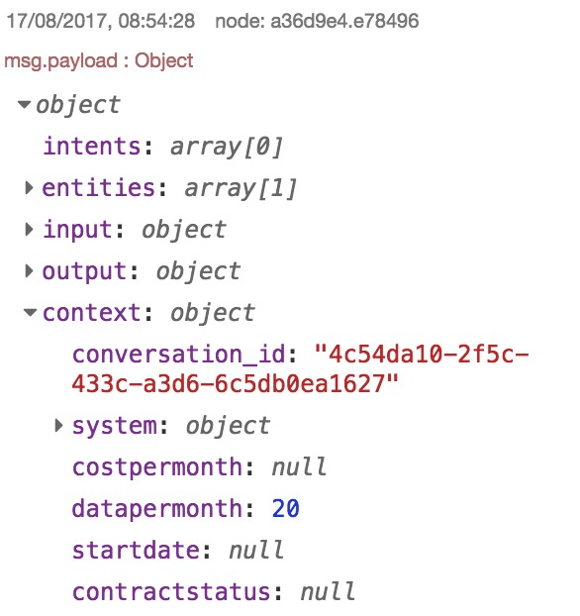
Context variables
Notes:
- Here, recognised #introductions intent
- Then, Watson picks up users name from the next input using
the @sys-person system entity ...
- ... stores it in context variable USERNAME ...
- ... and uses USERNAME further down the dialog tree when
the #purchase intent is picked up
- Context is passed to your Node-RED application via the CONTEXT data structure - you can see this when you use DEBUG in Node-RED

Slide 10
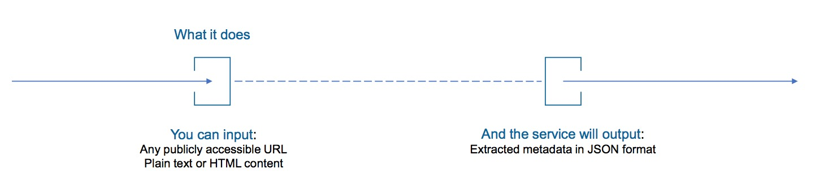
NLU Introduction
Easy to use semantic text analysis service
Uncovers insights from structured and unstructured data
extract metadata from content such as concepts, entities, keywords, categories, relations and semantic roles
Understand sentiment and emotion
Use cases
monitor sentiment and emotion in customer support chat transcripts
categorise blog posts - sort them based on general concepts, keywords, and entities
Full support for English, partial support for Spanish, French, Italian, Portuguese, German, Russian, Arabic, Swedish, Japanese

Slide 11
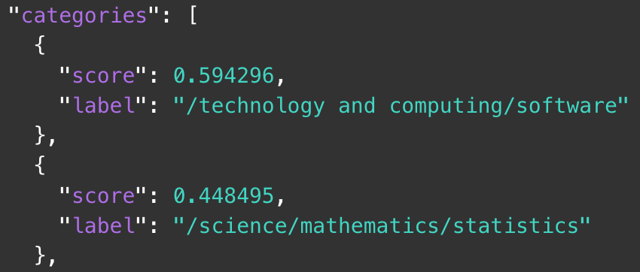
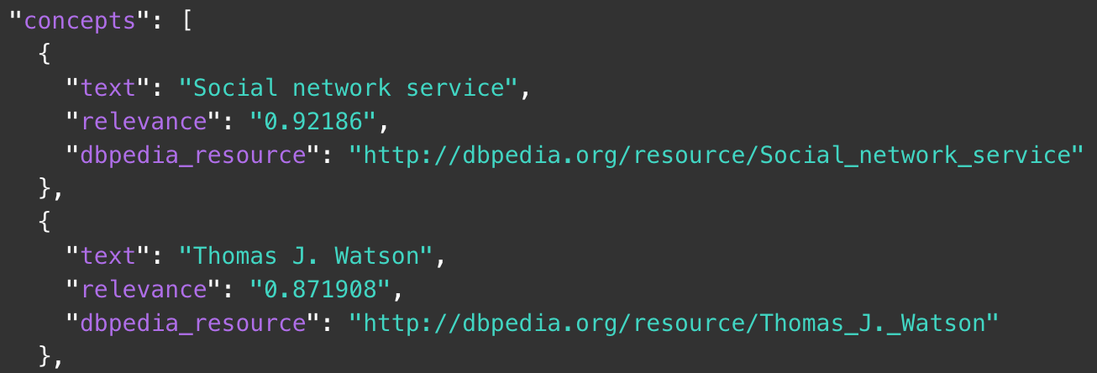
Available Features
Categories
5 level hierarchy
1000 categories available
Concepts
High level topics
Not always mentioned in the text
Notes:
Categories: Categorize your content using a five-level classification hierarchy. Full list available in documentation.
1000 categories overall
Concepts: Identify high-level concepts that aren't necessarily directly referenced in the text.

Slide 12
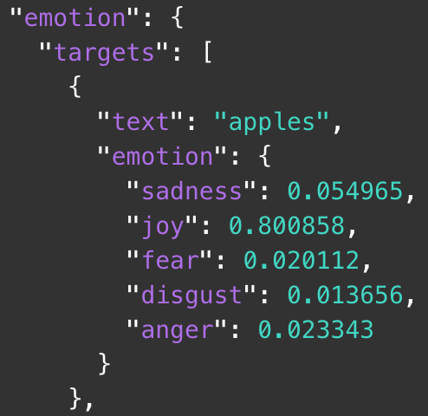
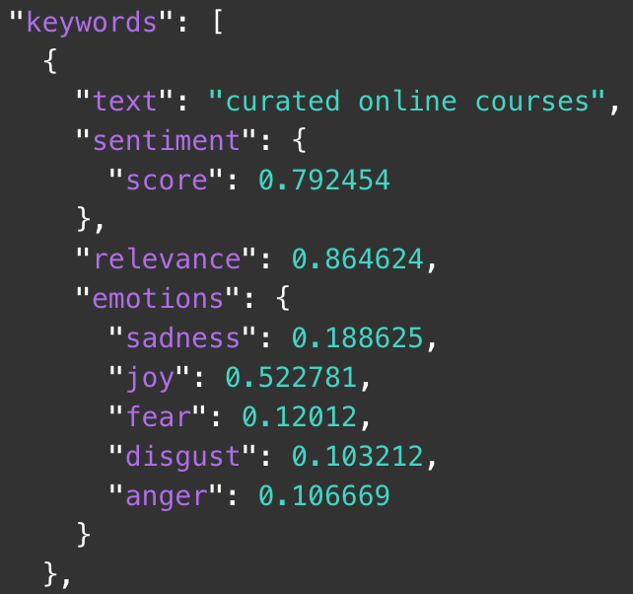
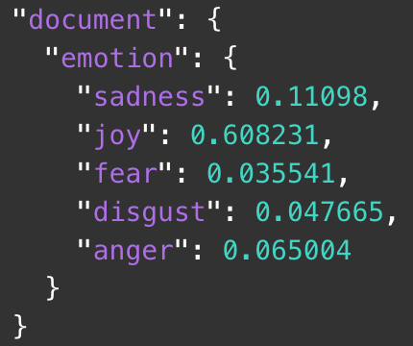
Available Features
Emotion
Sadness, joy, fear, disgust, and anger
Keywords
Key phrases in the document
Sentiment and Emotion can be detected
Notes:
Emotion: Analyze emotion conveyed by specific target phrases or by the document as a whole. You can also enable emotion analysis for entities and keywords that are automatically detected by the service.
Input
text: "I love apples, but I hate oranges." Response
"apples": joy "oranges": anger
Entities: Find people, places, events, and other types of entities mentioned in your content.
currently 21 entity types and 433 subtypes
Keywords: Search your content for relevant keywords.
Metadata: For HTML and URL input, get the author of the webpage, the page title, and the publication date
Relations: Recognize when two entities are related, and identify the type of relation. Different set of entities identified than in entities
53 relations available between 50 entity types
Semantic roles: Parse sentences into subject-action-object form, and identify entities and keywords that are subjects or objects of an action.
In other words it anwers who? What? And action that connects those two
Sentiment: Analyze the sentiment toward specific target phrases and the sentiment of the document as a whole. You can also get sentiment information for detected entities and keywords by enabling the sentiment option for those features.

Slide 13
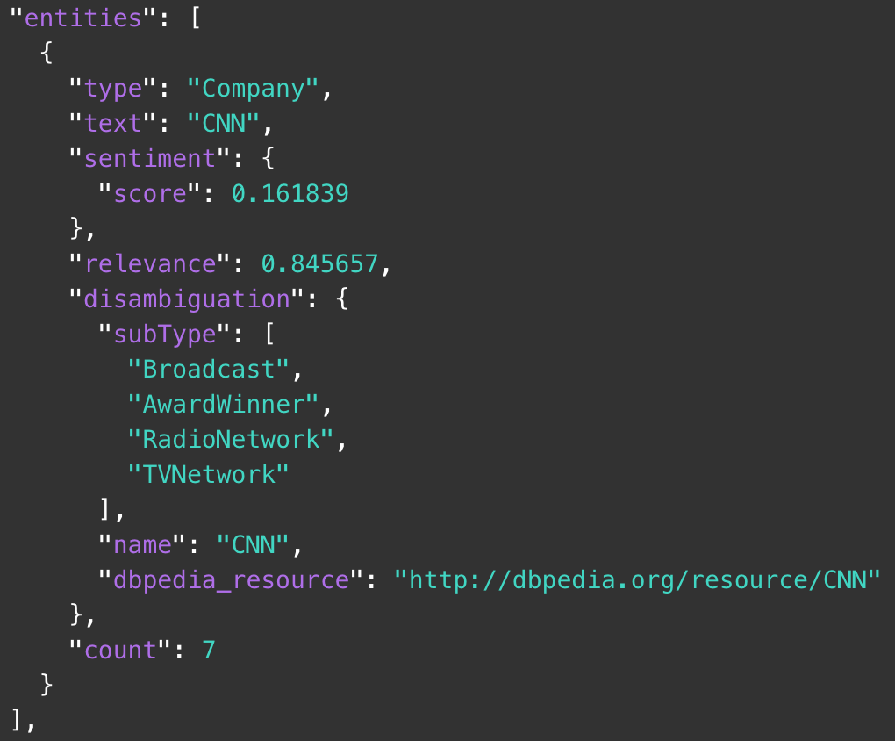
Available Features
Entities
Categorized keywords: people, places, events, …
Sentiment and Emotion can be detected
21 entity types and 433 subtypes
Notes:
Entities: Find people, places, events, and other types of entities mentioned in your content.
currently 21 entity types and 433 subtypes

Slide 14
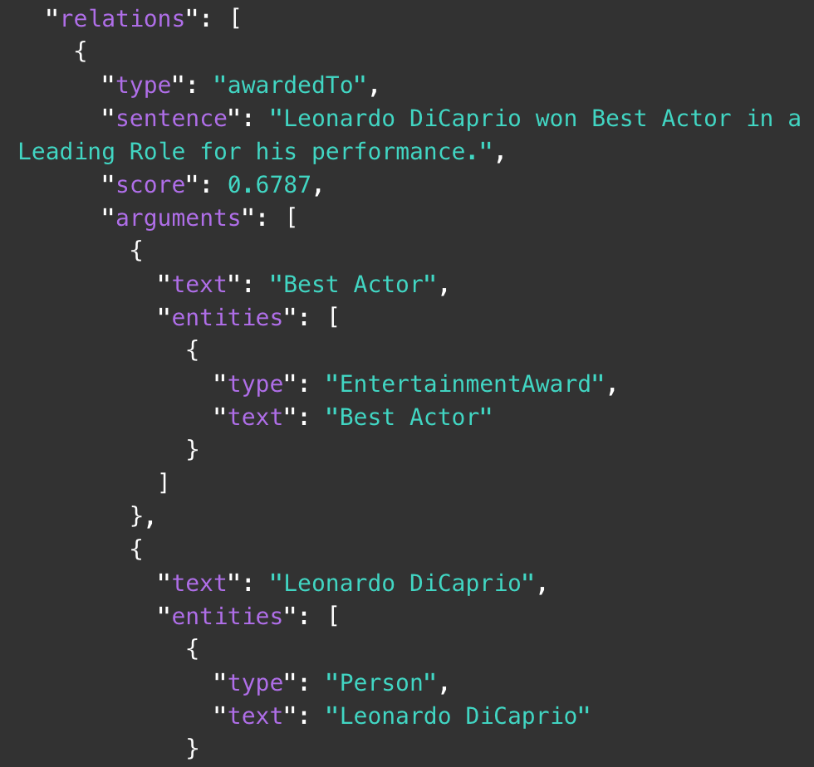
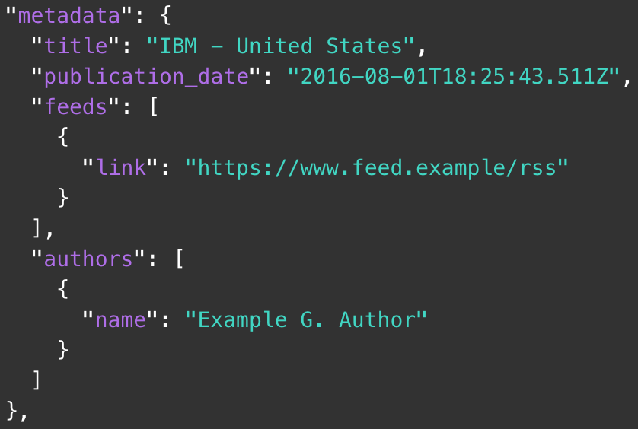
Available Features
Metadata
Author, title and date
Only for HTML and URL inputs
Relations
Between entities
53 relations and 50 entity types
Notes:
Metadata: For HTML and URL input, get the author of the webpage, the page title, and the publication date
Relations: Recognize when two entities are related, and identify the type of relation. Different set of entities identified than in entities
53 relations available between 50 entity types

Slide 15
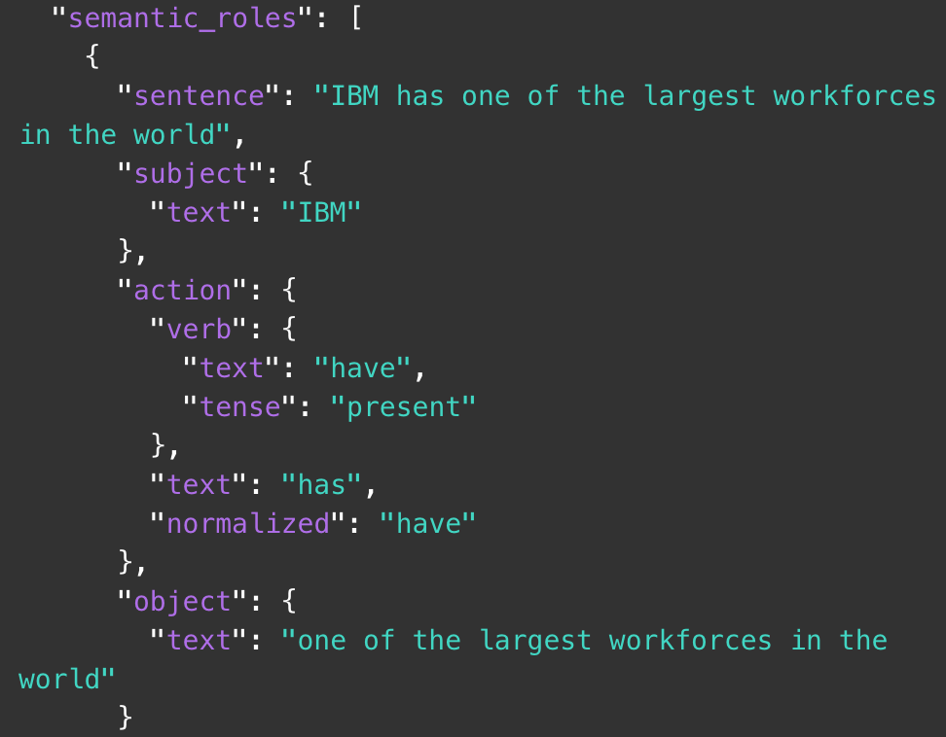
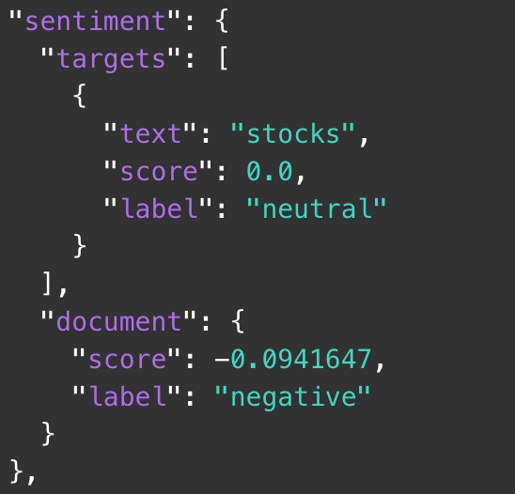
Available Features
Semantic Roles
Subject-action-object form
Sentiment
Whole document or targeted
Notes:
Semantic roles: Parse sentences into subject-action-object form, and identify entities and keywords that are subjects or objects of an action.
In other words it answers who? What? And action that connects those two
Sentiment: Analyze the sentiment toward specific target phrases and the sentiment of the document as a whole. You can also get sentiment information for detected entities and keywords by enabling the sentiment option for those features.

Slide 16
NLU in our chatbot
Passed to NLU
Response based on sentiment
Passed to NLU
Response based on sentiment

Slide 17
Cognitive: Extended Gary Wilson CTO & Technical Leader, UKI Commercial Business

